Slide 1

2025
MOVIE RELEASE TIMING ANALYSIS
AISYAH NABILLAH
02113068
How Release Timing Affects Movie Success
Statistical Analysis of 651 Movie

Slide 2
DATASET
OVERVIEW
Dataset Characteristics:
Source: Rotten Tomatoes & IMDB APIs
Sample Size: 651 randomly sampled movies (pre-2016)
Variables: 32 variables including ratings, genres, timing, awards
Response Variable: IMDB rating (Mean: 6.49, Range: 1.9-9.0)
Data Quality:
✅ Generalizability: Random sample, sufficient size
⚠️ Causality: Observational data = associations only

Slide 3

RESEARCH QUESTION
"How do release timing factors (month, season) affect movie ratings and commercial success?"
Why This Question Matters:
Movie studios invest millions in production and marketing
Release timing is one of few factors studios can control
Understanding timing patterns can optimize release strategies
What We're Looking For:
Are there optimal months in the calendar for high ratings?
Do certain months favor commercial vs. critical success?
How strong are timing effects compared to content quality?

Slide 4
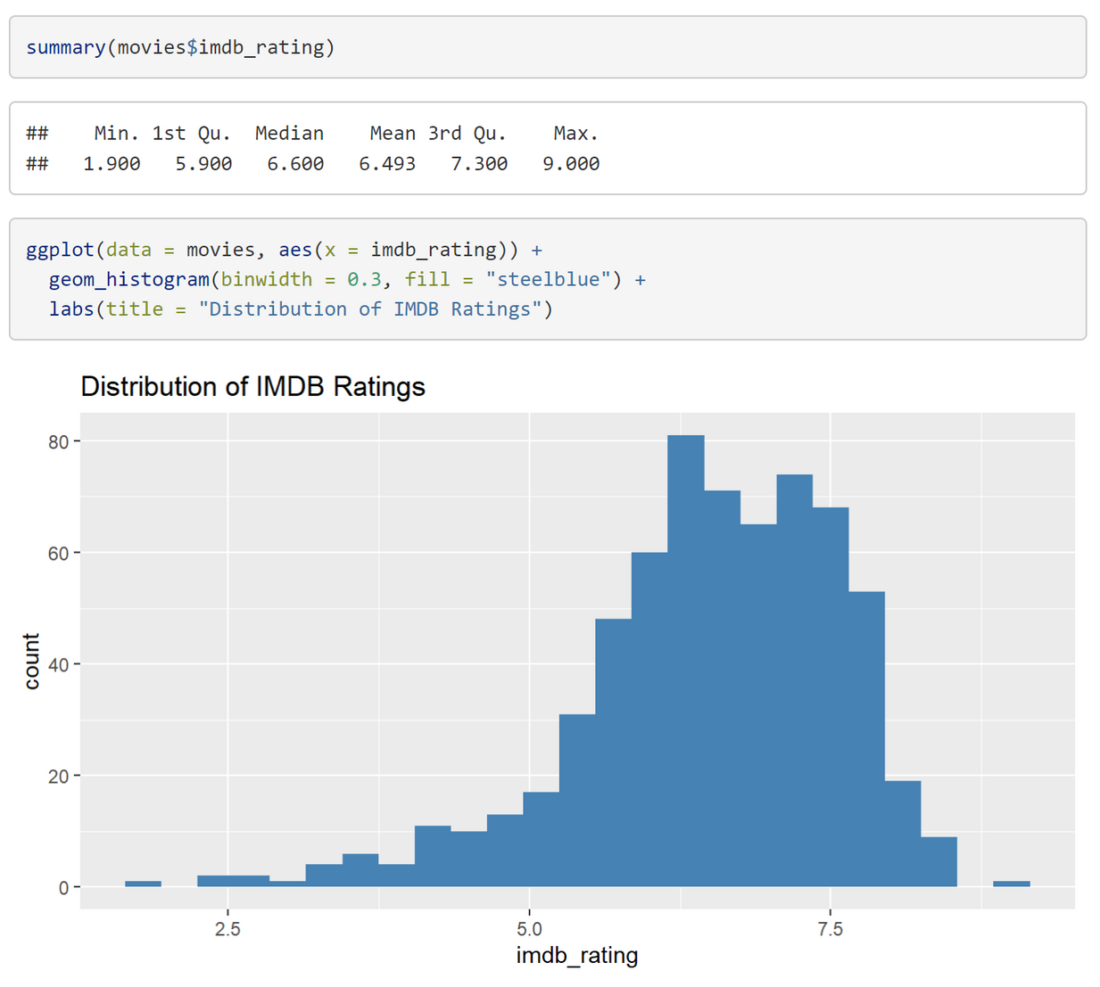
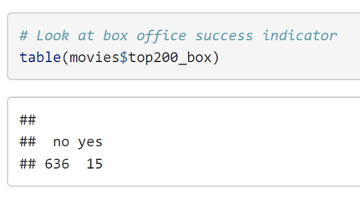
Exploratory Data Analysis
IMDB RATING DISTRIBUTION
Response Variable: IMDB Ratings
Mean: 6.493 out of 10
Median: 6.60
Range: 1.9 to 9.0
Distribution: Approximately normal (good for regression)
Most movies rated between 5.9 - 7.3
Commercial Success Context:
Only 15 out of 651 movies (2.3%) reached Top 200 box office
Most movies focus on critical reception over blockbuster success

Slide 5
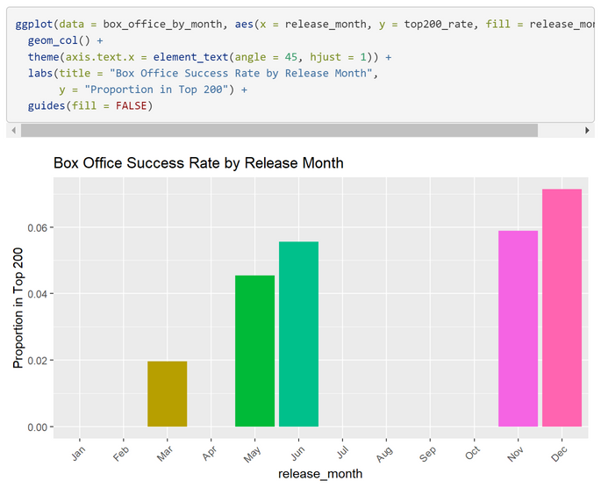
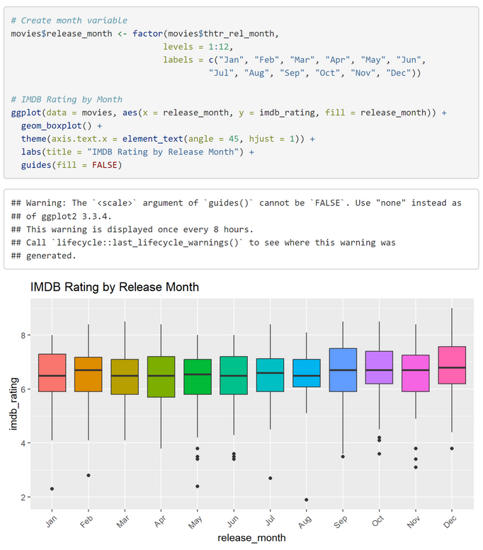
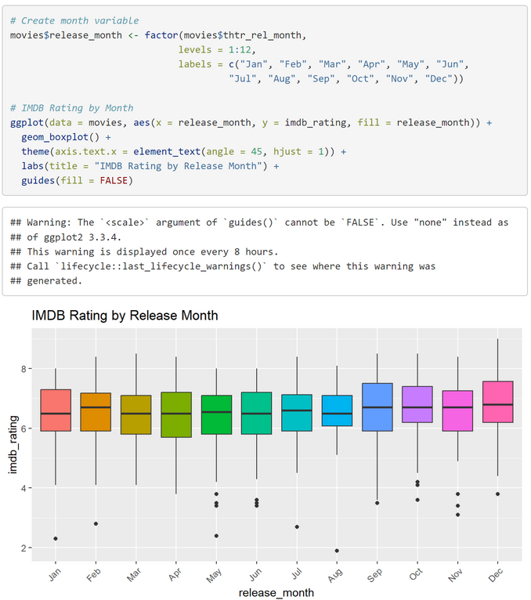
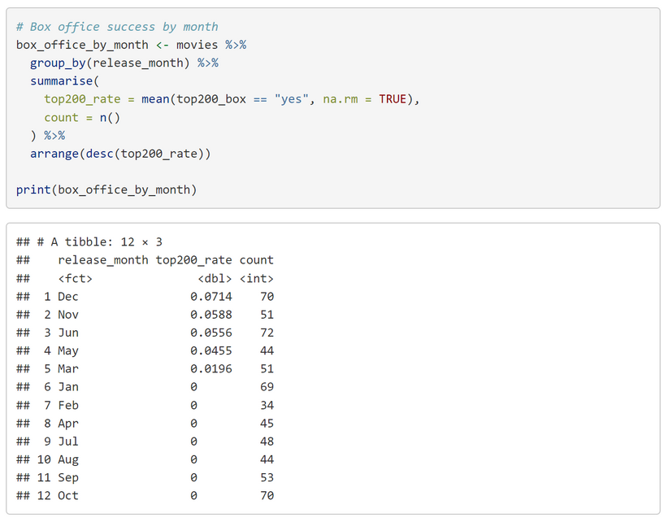
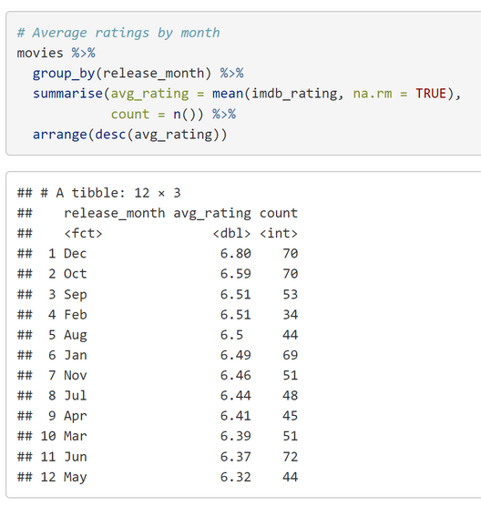
Exploratory Data Analysis
RELEASE MONTH PATTERNS
Key Findings - IMDB Ratings by Month:
Highest Average: December (6.8), October (6.59)
Lowest Average: May (6.32), June (6.37)
Awards season months (Oct-Dec) perform best
Box Office Success by Month:
December & November lead in top-200 rate
Awards season balances critical + commercial
Pattern: Trade-off between critical acclaim and commercial success

Slide 6
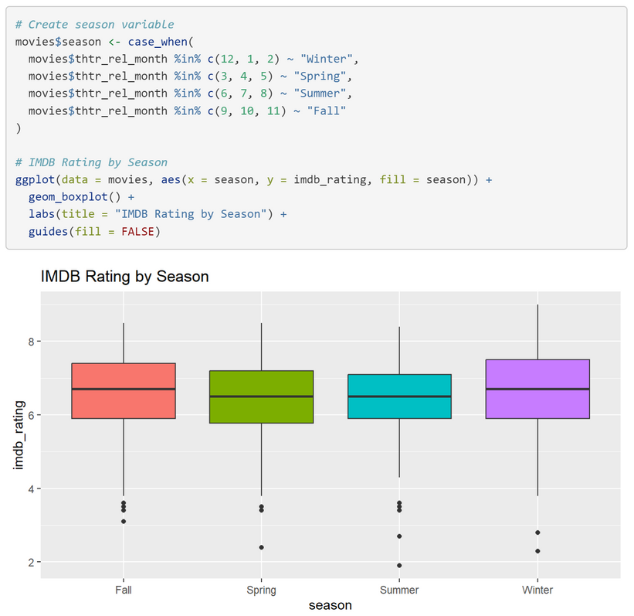
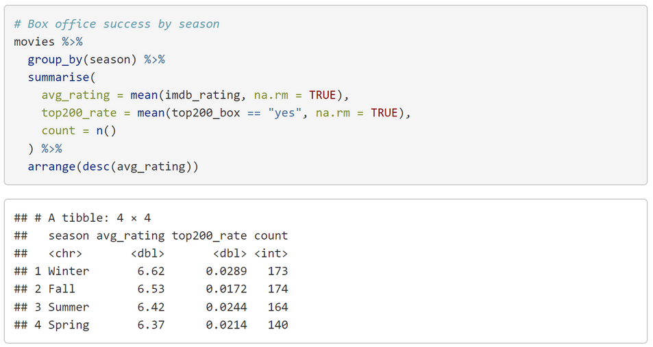
Exploratory Data Analysis
SEASONAL ANALYSIS
Average IMDB Ratings by Season:
Winter: 6.62 (173 movies) - Awards season advantage
Fall: 6.53 (174 movies)
Summer: 6.42 (164 movies)
Spring: 6.37 (140 movies)
Box Office Success Rates:
Winter: 2.9% - Quality over commerce
Summer: 2.4% - Expected higher, but competitive
Spring: 2.1%
Fall: 1.7%
Key Insight: Winter releases achieve both higher ratings AND box office success

Slide 7
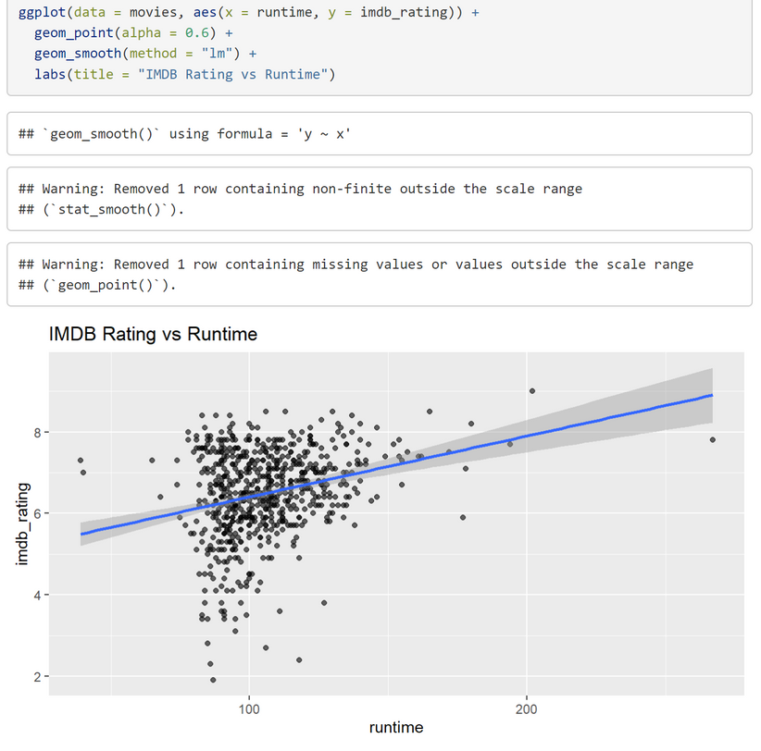
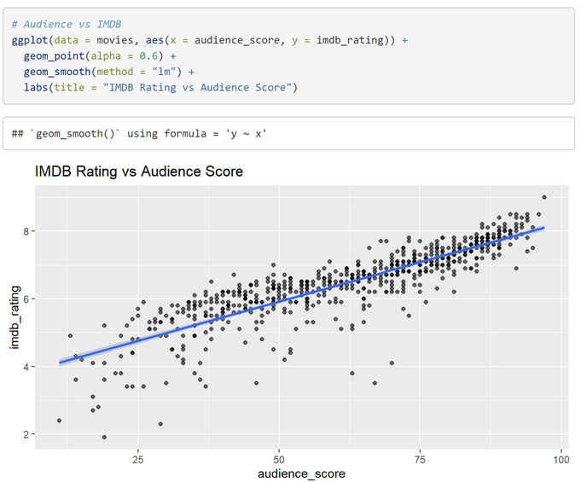
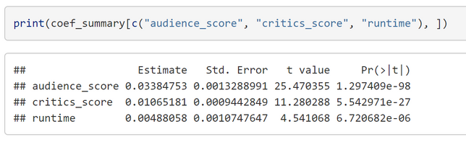
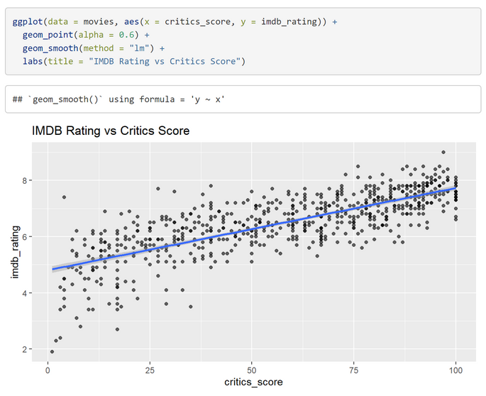
Exploratory Data Analysis
OTHER KEY RELATIONSHIPS
Model Coefficients:
Audience Score: 0.0338 (t = 25.47, very significant)
Critics Score: 0.0107 (t = 11.28, very significant)
Runtime: 0.0049 (t = 4.54, significant)
Genre Effects from Model:
Documentary: +0.23 (significant, p = 0.017)
Mystery & Suspense: +0.25 (significant, p = 0.004)
Animation: -0.42 (significant, p = 0.014)
Comedy: -0.15 (significant, p = 0.047)

Slide 8
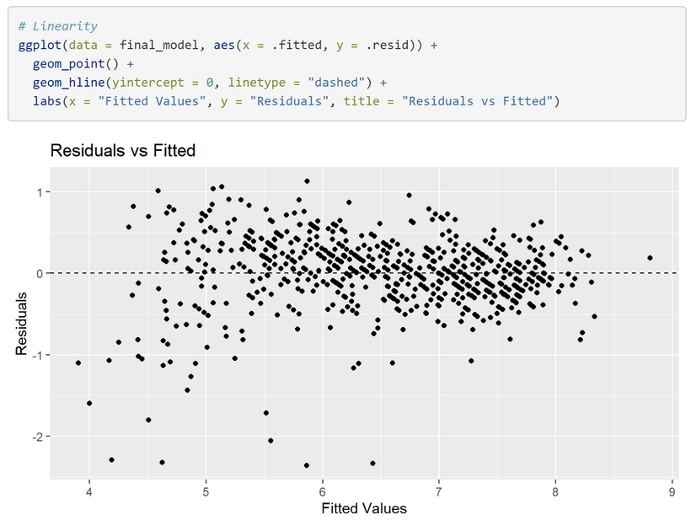
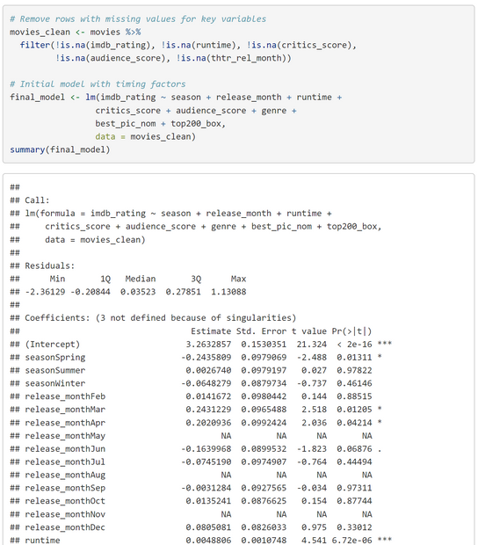
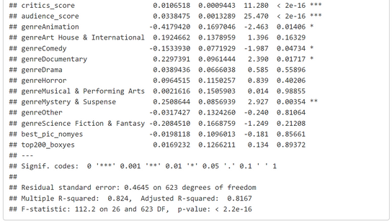
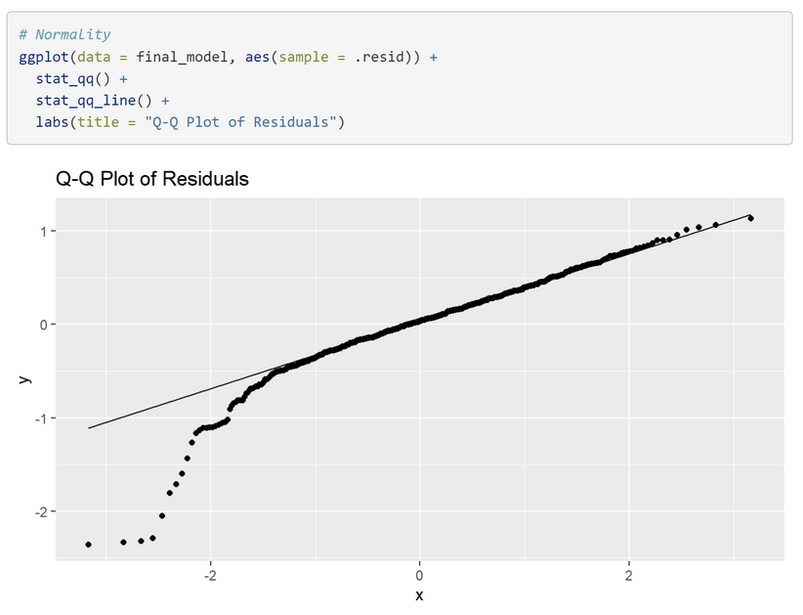
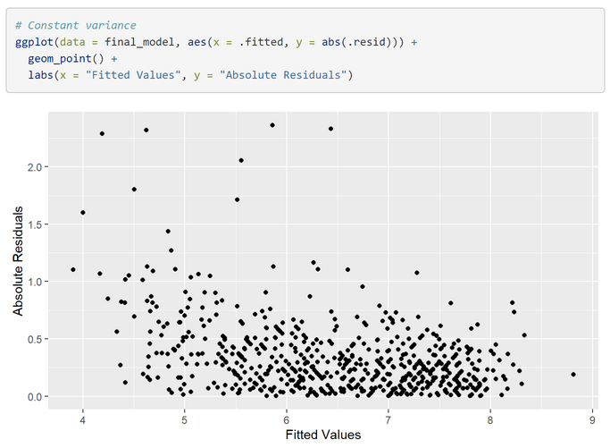
Modelling
STATISTICAL MODEL RESULTS
Model Performance:
Adjusted R²: 81.7% (explains variance very well)
Key Predictors (coefficients):
Audience Score: +0.034 per point
Critics Score: +0.011 per point
Runtime: +0.005 per minute
Timing Effects:
Spring: -0.24 points vs Fall (reference)
March: +0.24 points vs January
April: +0.20 points vs January
Model Quality: All assumptions met ✅

Slide 9
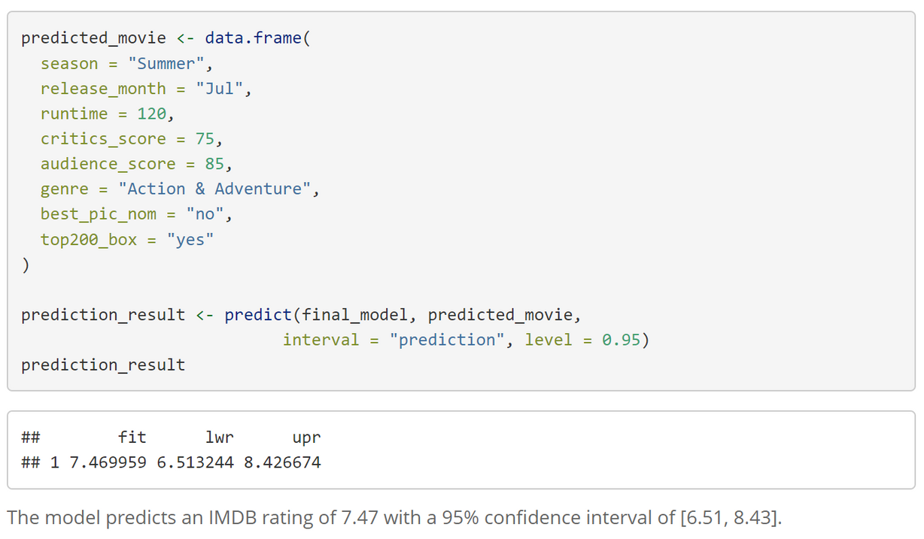
Prediction
PREDICTION EXAMPLE
Scenario: Summer Blockbuster (July Release)
Runtime: 120 minutes
Critics Score: 75
Audience Score: 85
Genre: Action & Adventure
Prediction Results:
Predicted IMDB Rating: 7.47
95% Confidence Interval: [6.51, 8.43]
Interpretation: Strong predicted performance for a summer release

Slide 10
CONCLUSION
Strategic Implications:
Awards contenders: Target winter releases
Commercial blockbusters: Summer still viable but competitive
Quality trumps timing: Good content succeeds regardless of release date
Model Strength: 81.7% variance explained - highly predictive model
Key Findings:
Winter releases perform best (6.62 avg rating)
December is optimal month for both quality and commerce
Spring shows penalty (-0.24 rating points)
Content quality still dominates (audience/critics scores most important)

Slide 11
THANK YOU!

